Slide 1
Angular 2 Tutorial
A little try from Karin

Slide 2
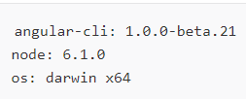
Initialisation
Get to our all installation and type
ng version
Result should be:
npm –v give the version of the installed npm
For installing the Trainingsenvironment type
ng new todo-app
Navigate to new directory: cd todo-app
ng serve → http://localhost:4200/

Slide 3

Creating the Todo Class
ng generate class Todo -- spec → ng g cl <filename> --spec
Open src/app/todo.ts
Add the logic we need:
id: number;
title: string = '';
complete: boolean = false;
constructor(values: Object = {}) {
Object.assign(this, values);

Slide 4
Providing constructor logic for more convinience
Still in src/app/todo.ts
let todo = new Todo({
title: 'Read SitePoint article',
complete: false
});
So we can easily create new Todo instances like the above

Slide 5
Easy Test Setup
Generating the Todo class with --spec option gives a second file with path & name: src/app/todo.spec.ts + basic unit test
import {Todo} from './todo';
describe('Todo', () => {
it('should create an instance', () => {
expect(new Todo()).toBeTruthy();
});
Add an additional unit test making sure constructor logic works as expected

Slide 6
Additional Unit Test
it('should accept values in the constructor', () => {
let todo = new Todo({
title: 'hello',
complete: true
});
expect(todo.title).toEqual('hello');
expect(todo.complete).toEqual(true);
});
});
Start verifing with: ng test

Slide 7
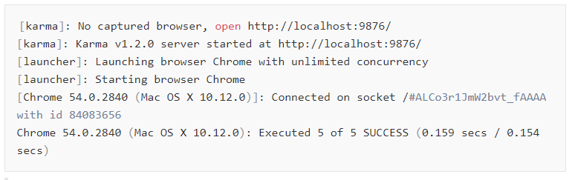
Result when everything worked fine
If not get the according code by this link: Example gitHub

Slide 8

Creating TodoDataService Service
This is not about REST API, this is just a store of data in memory
Using the Angular CLI again which will generate the service for us:
ng generate service TodoData → ng g s <filename>
Result (no --spec. When Angular CLI creates a Service this is implicit there) :

Slide 9
todo-data.service.ts + todo-data.service.spec.ts
Insert both files according to the names by copy & paste

Slide 10
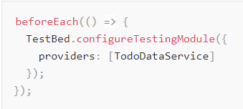
Some definitions
TestBed: Utility provided by @angular/core/testing create and configure Angular testing modules
TestBed.configure(): Method to configure and create a new Angular testing module configuration could be done by passing a configuration object. This could have most of the properties of a normal Angular Module.

Slide 11
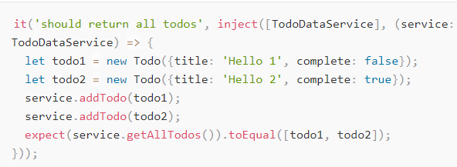
Inject: function provided by @angular/core/testing to inject correct service form the TestBed injector.
Here we tell the TestBed injector to inject the TodoDataService by specifying it in the array in the First argument. As a result we can access the TodoDataService as service in our test function because service is the name of the first parameter of Out test function.

Slide 12
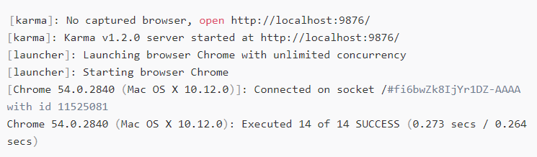
ng test
Result:

Slide 13
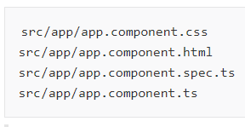
Editing the AppComponent Component
Go to Link:
angular-2-tutorial --> section: editing the AppComponent Component
Initializing the Todo application also the following main AppComponent component was generated by Angular CLI
start with editing the src/app/app.component.html

Slide 14
Change app.component.html
Super-short primer on Angular‘s template syntax
[property]=„expression“: set property of an element to the value of expression
(event)=„statement“: execute statemetn when event occured
[(property)]=„expression“:create two-way binding with expression
[class.special]=„expression“:add special CSS class to element when the value of expression is truthy
[style.color]=„expression“: set color CSS property to the value of expression

Slide 15
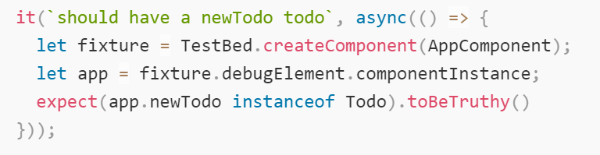
app.component.xx files

Slide 16
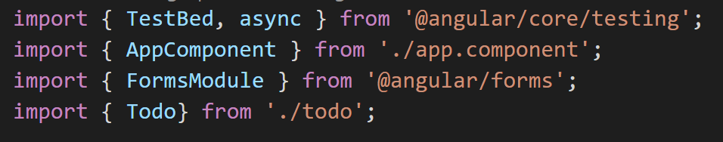
Changes for let the app working correct app.Component.spec.ts
The imports in app.component.spec.ts are too few, please change them to the following:

Slide 17
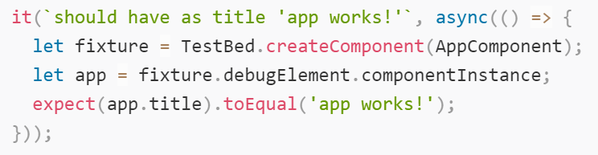
app.Component.spec.ts
New title and: expect(app.newTodo instanceof Todo).toBeTruthy();

Slide 18
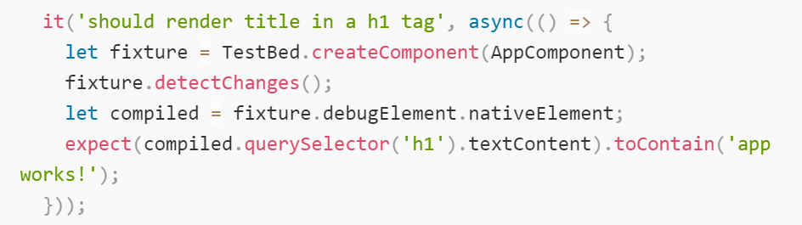
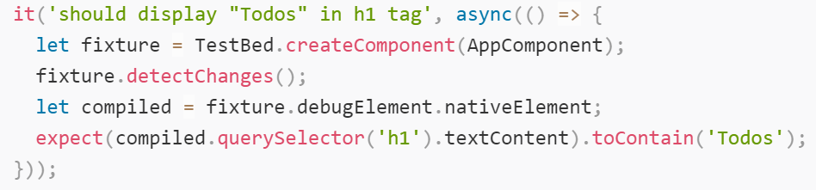
app.Component.spec.ts
Change title and: expect(compiled.querySelector('h1').textContent).toContain('Todos');

Slide 19
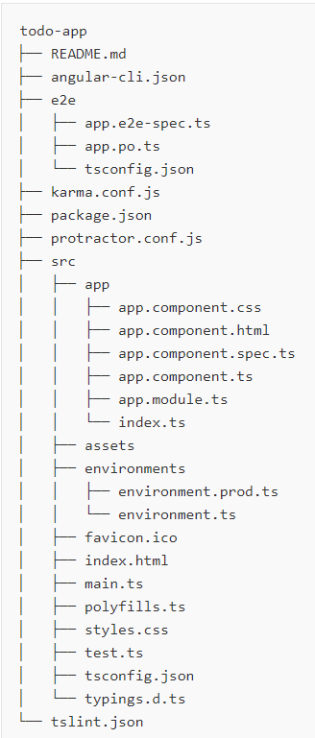
Backup
File Order for todo-app

Slide 20
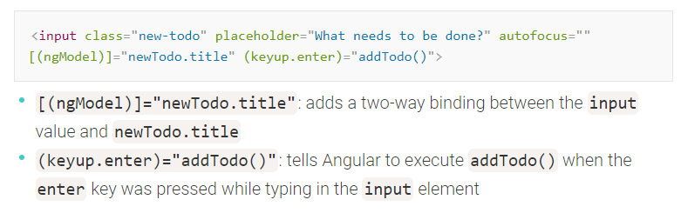
Explanation of the html page

Slide 21
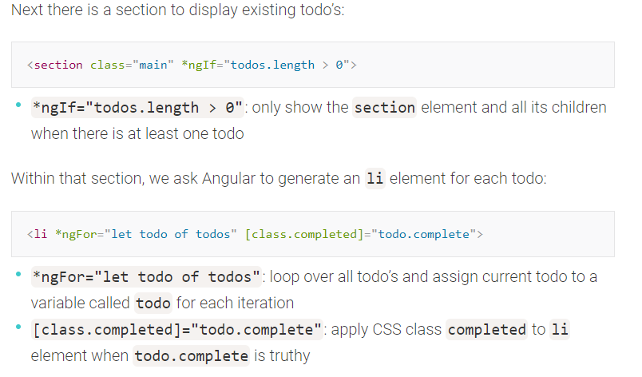

Slide 22
